Slide 1
UNIT
DAY 2
01
WHAT MAKES A GAME?
GAMES OF LOGIC
AGENDA
REMINDERS
Put your phones into The Holding Cell
Put your computers away, you won’t be needing them
Warm Up Question
Unit 1 Design Situation
Mechanic vs Theme
Design Constraints
Station Rotation
Dissection Sheet
Thoughts?

Slide 2
THE WARM UP QUESTION
Name a board or card game you’ve played more than ten times. In one sentence, what kept you coming back. Was it the theme or the rules?

Slide 3
THE WARM UP ANSWER
Name a board or card game you’ve played more than ten times. In one sentence, what kept you coming back. Was it the theme or the rules?

Slide 4
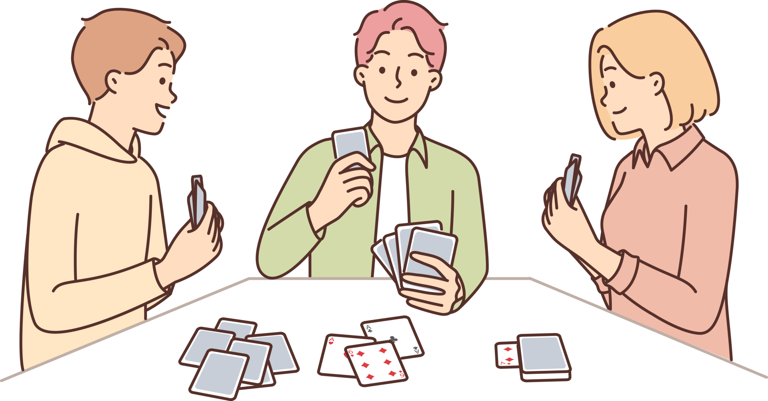
UNIT 1 DESIGN SITUATION
“Games of Logic”
The Problem:
Many classes, advisories, and clubs end with ~15 dead minutes; and many board games take just as long to explain as they do to play.
The Deliverable:
An original game, print and play, built on a computer science concept
Delivery date:
In-class playtest: 9/29
Final due date with peer testing: 10/13

Slide 5
MECHANIC VS THEME
Mechanic
Game mechanics are the rules, actions, and systems that govern player behavior and interactions within a game. They determine what a player can do, how the game reacts, and how challenges, progress, and rewards are structured.
Theme
A game theme is the imaginative context, setting, or story that gives the game its “why” - the background and atmosphere that make players feel like they are part of a specific world or situation.

Slide 6
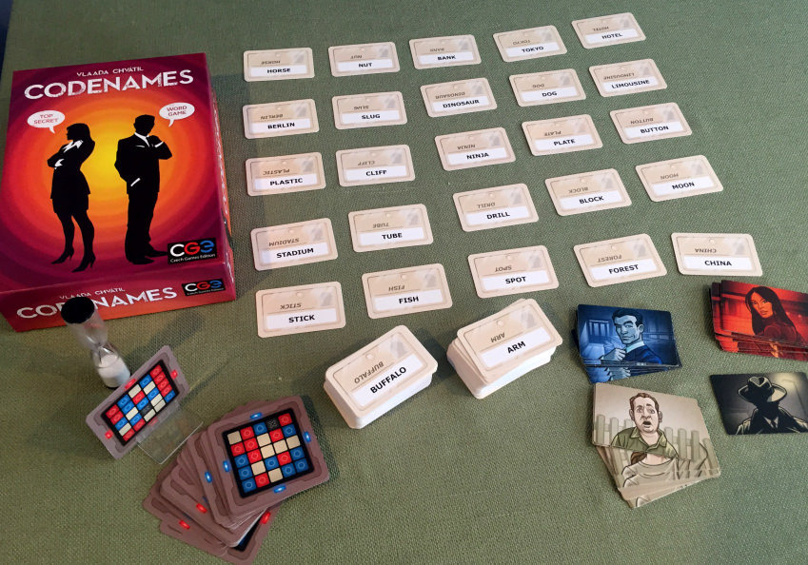
MECHANIC VS THEME
Show of hands – who here has played Codenames?

Slide 7
MECHANIC VS THEME
What are the mechanics in codenames?
What is the theme of codenames?

Slide 8
MECHANIC VS THEME
Could you easily change the mechanic?
How about the theme?

Slide 9
MECHANIC VS THEME
In the way that the mechanic of Codenames is ‘language’, the mechanic of your game will be ‘Computer Science’ related
You shouldn’t be able to swap Computer Science for any other mechanic, but your theme can be whatever you want!

Slide 10
CONSTRAINTS
Questions?
Teachable in 3 Minutes | If the rules take longer to explain than to play, it fails to fit in the space allotted.
Playable in 10 Minutes | It has to fit into a dead 15 minute timespan, per the design situation.
Rules fit on one page | One side of an A4 sheet of paper, any diagrams included.
54 components (game objects) maximum | Cards, tiles, tokens, etc. combined. A standard card deck is the ceiling.
2-4 players | Anything needing five or more players increases complexity and reduces likelihood of playing
The Concept is Load-Bearing | If you can reskin the mechanic so the computer science disappears and the game still works, you have a theme, not a mechanic. Try again.
Digital Artifact Required | Paper prototype for iteration; the deliverable is a print-and-play PDF file or scratch game (must be multiplayer). This is what allows the game to be well distributed and easily set up by anyone.

Slide 11

GAME ROTATION
Let’s try some smaller games for inspiration!
Be sure you’re thinking about what the mechanics are and what the themes are while you play
Run a timer for both how long it takes to start playing the game, alongside how long the game takes to play
Use your phone for this
NOW GO!

Slide 12
DISSECTION SHEET
Now fill out the game design dissection sheet and prepare to share your findings with the class

Slide 13
DISSECTION SHEET
Now, let’s share!
Let’s chart the teach-times and play-times of each games

Slide 14
CLOSING
Next time, we start collecting mechanics to create our games about, and the first place we’ll look is binary!

